Slide 1
Trust, Reputation & Security Management

Slide 2
Trust & Reputation
Trust - refers to the belief of one peer on another, based on his direct experiences with the peer
Reputation - a collective opinion on a peer by other peers based on recommendations
Distinguish good peers from bad ones has to be done through a scientific screening process

Slide 3
Trust Matrix for Computing Reputations
trust matrix M(t) = [m_{ij}(t)]
where m_{ij}(t) is the local score issued by node i in evaluating node j at time t
All trust scores are fractions in the range (0, 1) with 0 meaning no trust (or no contact) and 1 for 100 percent trust
global reputation score – weighted average of local scores
Reputation Vector

Slide 4
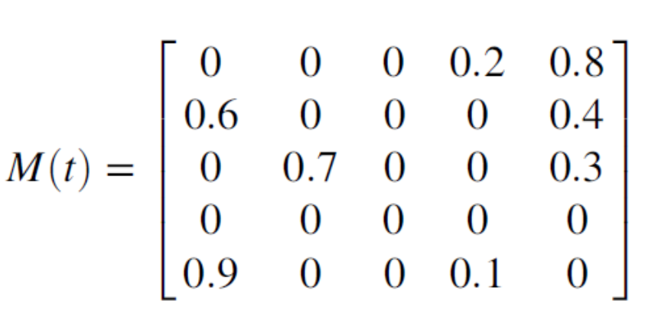
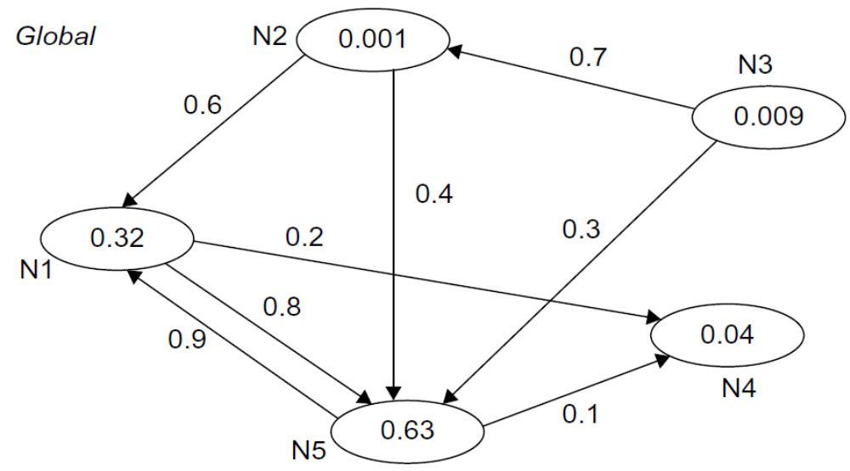
Trust Matrix for Computing Reputations
Local Reputation Score: Node i evaluates Node j at time t (m_{ij}[t])
Global Reputation score: Weighted average of all Local Scores of Peers
Local

Slide 5
Reputation Systems
Calculates the global reputation score of a peer by considering the opinions (i.e., feedback) from all other peers that have interacted with this peer.
To measure peer reputations, one can set up an evaluation system. After each transaction, the two participant parties evaluate each other by giving an honest score like in eBay.
This advises us to assign different weights to votes based on the voting peers’ reputations.

Slide 6
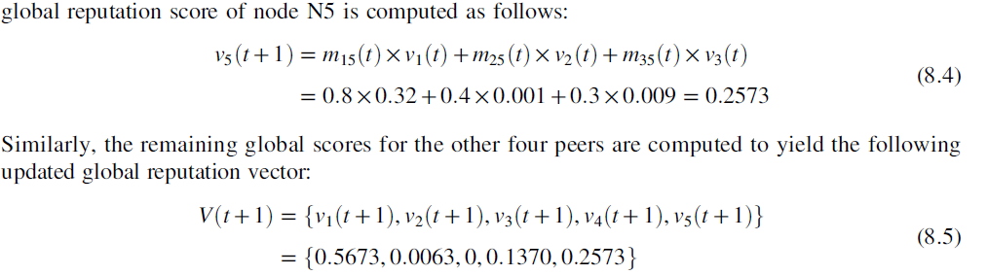
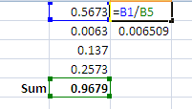

Global Reputation Score Calculation
Normalization

Slide 7
Design Objectives of Reputation Systems
High Accuracy: Distinguish reputable peers from malicious ones
Fast Convergence Speed: Reputation aggregation should converge fast
Low Overhead: Consume limited computation and bandwidth resources
Adaptive to peer dynamics: Peer joins and leaves an open P2P system dynamically.
Robust to malicious peers: Various attacks by both independent and collective malicious peers.
Scalability: large number of peers in terms of accuracy, convergence speed, and extra overhead per peer

Slide 8
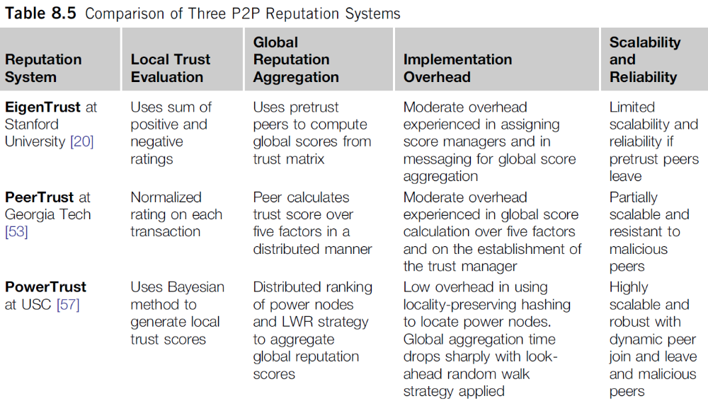
Three Representative Peer Systems
Notes:
[20] S. Kamvar, M. Schlosser, H. Garcia-Molina, The Eigentrust algorithm for reputation management in P2P networks, ACM WWW ’03, Budapest, Hungary, 2003.
[53] L. Xiong, L. Liu, Peertrust: supporting reputation-based trust for peer-to-peer electronic communities, in: IEEE Transactions on Knowledge and Data Engineering, Vol. 16 (7), 2004, pp. 843–857.
[57] R. Zhou, K. Hwang, PowerTrust for fast reputation aggregation in peer-to-peer networks, in: IEEE Transactions on Parallel and Distributed Systems, April 2007, pp. 460–473.

Slide 9
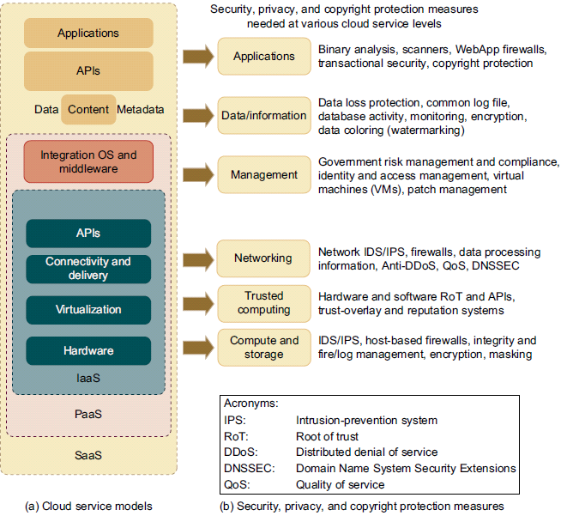

Security

Slide 10
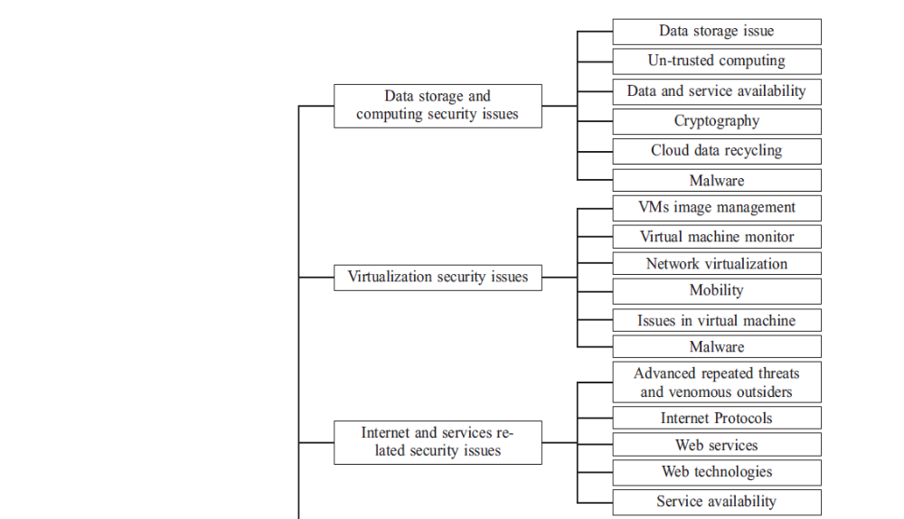
Current state of Cloud Security Issues
Notes:
Ashish Singh, Kakali Chatterjee, Cloud security issues and challenges: A survey, Journal of Network and Computer Applications 79 (2017) 88–115

Slide 11
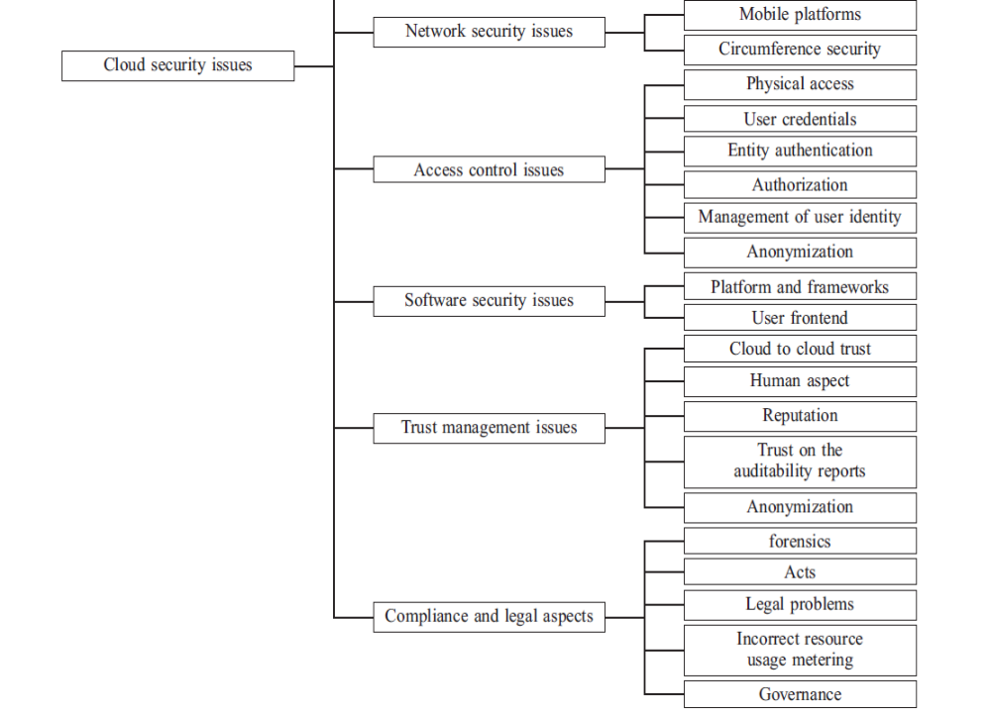
Current state of Cloud Security Issues
Notes:
Ashish Singh, Kakali Chatterjee, Cloud security issues and challenges: A survey, Journal of Network and Computer Applications 79 (2017) 88–115

